Slide 1

Computational astrobiology hackathon
Thara Caba
University of Belgrade

Slide 2
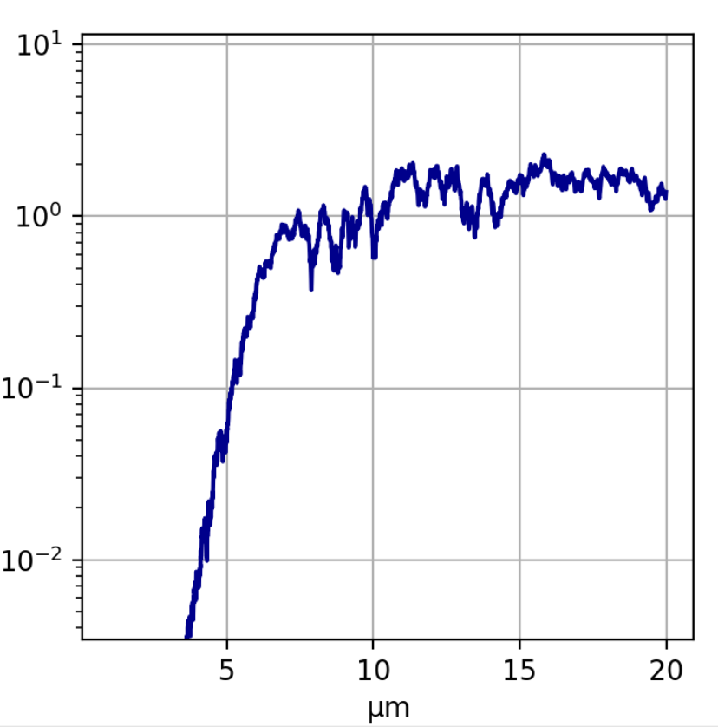
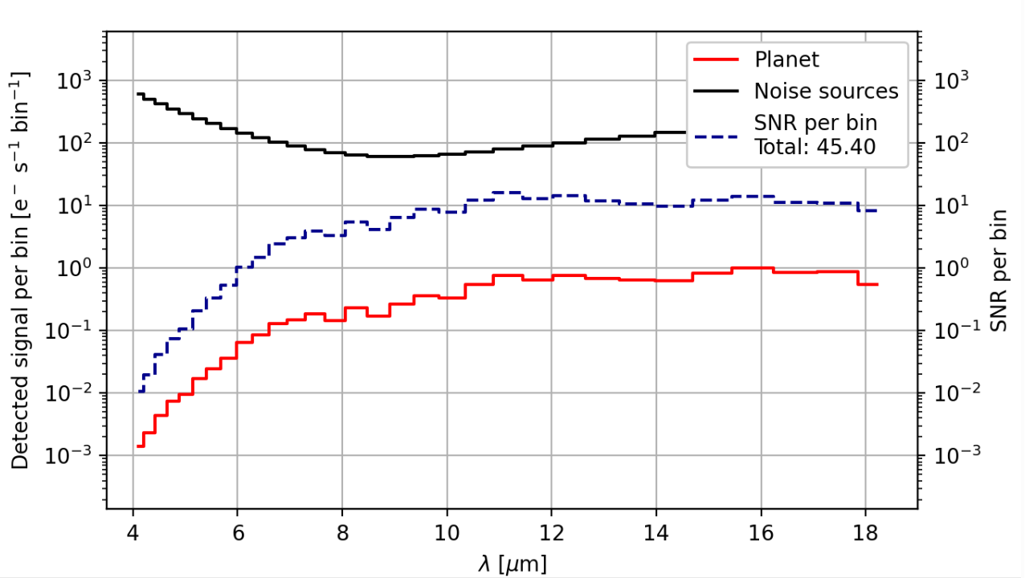
Tutorial 1: LIFEsim
Objective: install LIFEsim and simulate a catalogue of exoplanets and simulate spectrum of exoplanet.
Example of simulating a spectral observation of an exoplanet with the LIFEsim GUI:

Slide 3
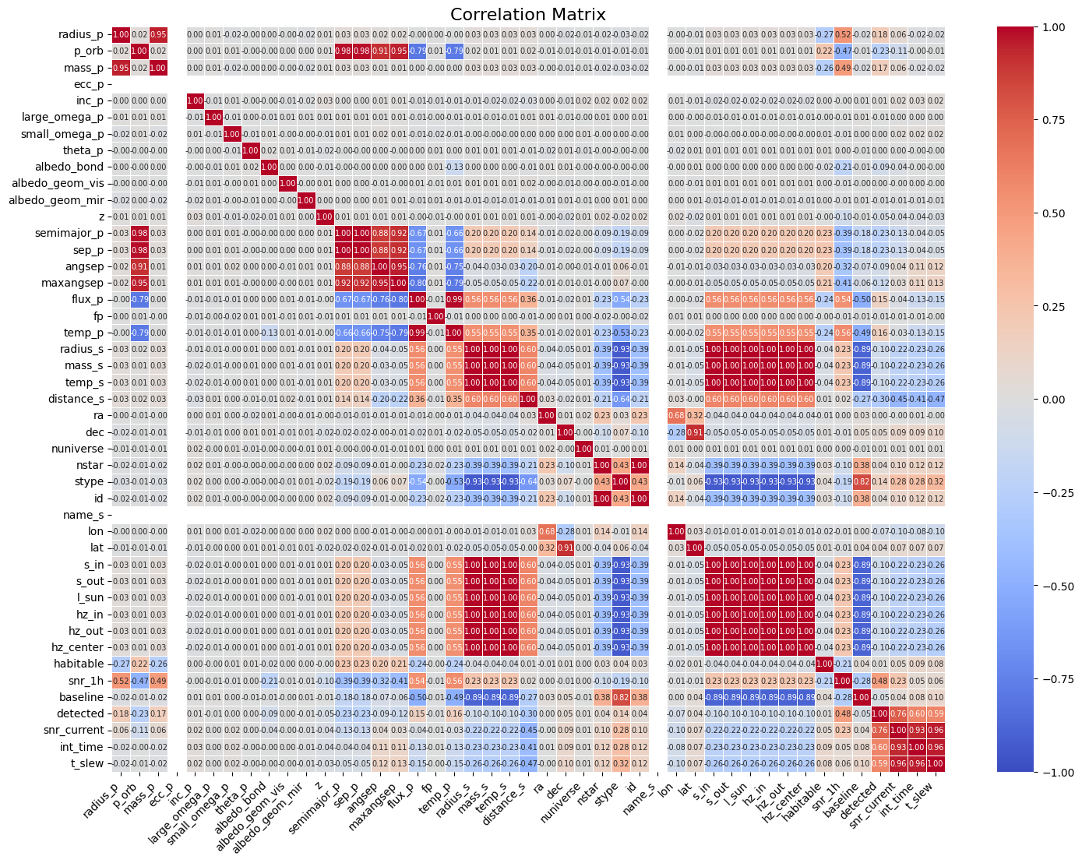
Tutorial 1: Innovation
Column 'radius_p' has the highest correlation with column 'mass_p' with a correlation of 0.95
…

Slide 4
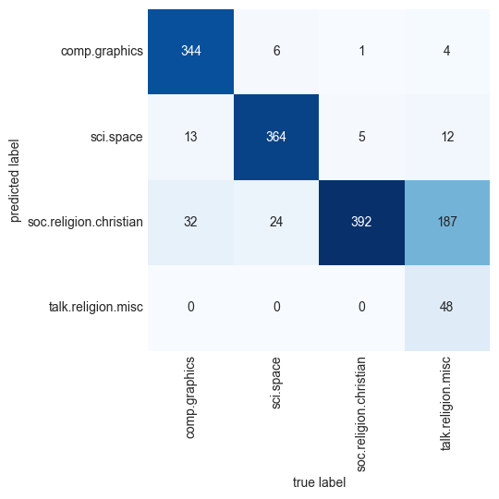
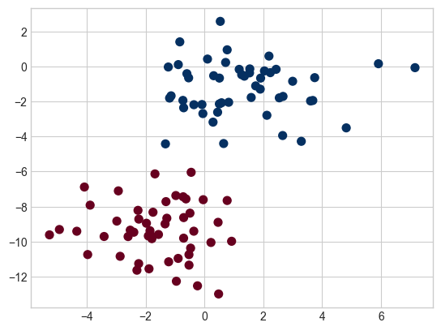
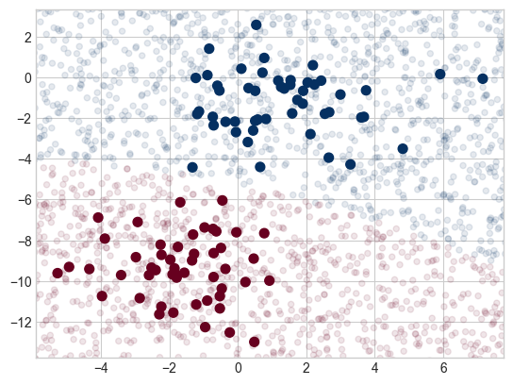
Tutorial 2: Naive Bayes
Objective: make own case of Naive Bayes by using some exoplanet data.
Naive Bayes models are a group of extremely fast and simple classification algorithms that are often suitable for very high-dimensional datasets. Because they are so fast and have so few tunable parameters, they end up being useful as a quick-and-dirty baseline for a classification problem.

Slide 5
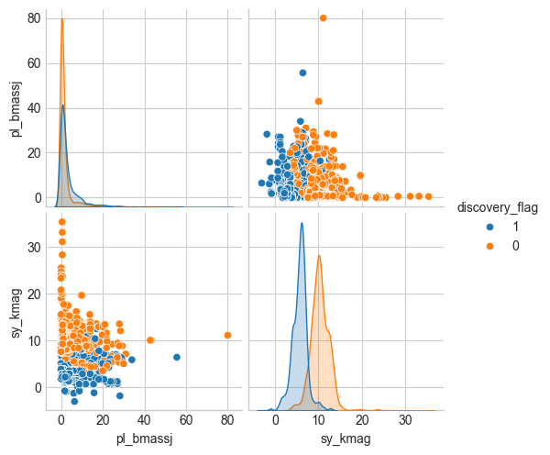
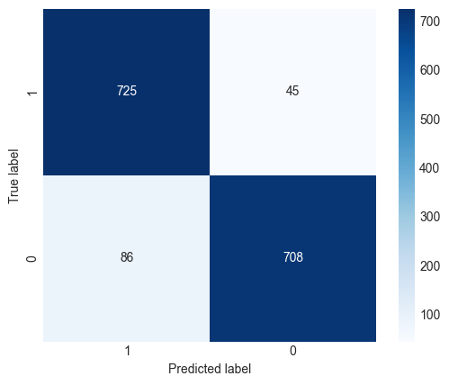
Tutorial 2: Innovation
I downloaded data from the NASA exoplanet archive. Some planets were detected by direct imaging or by transit. I clasified the planets by their detection method with naive bayes.

Slide 6
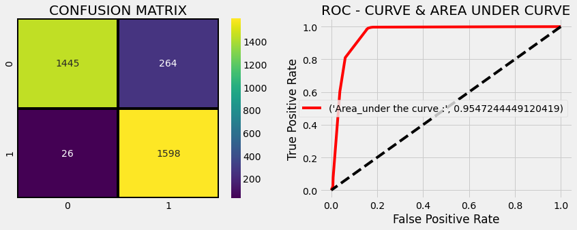
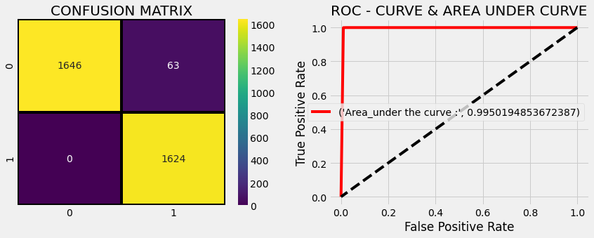
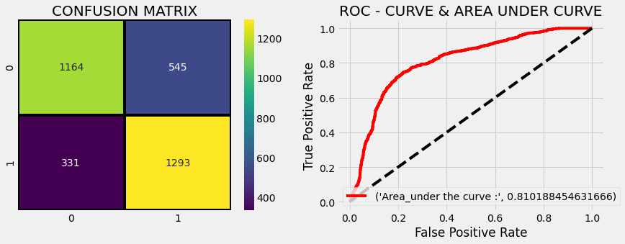
Tutorial 3: Exoplanet exploration using Machine Learning
Objective: Learn some machine learning techniques applied on classification of exoplanets using programs by Data analyst Nagesh Singh Chauhan.
Decision Tree
K Neighbors
Logistic Regression

Slide 7
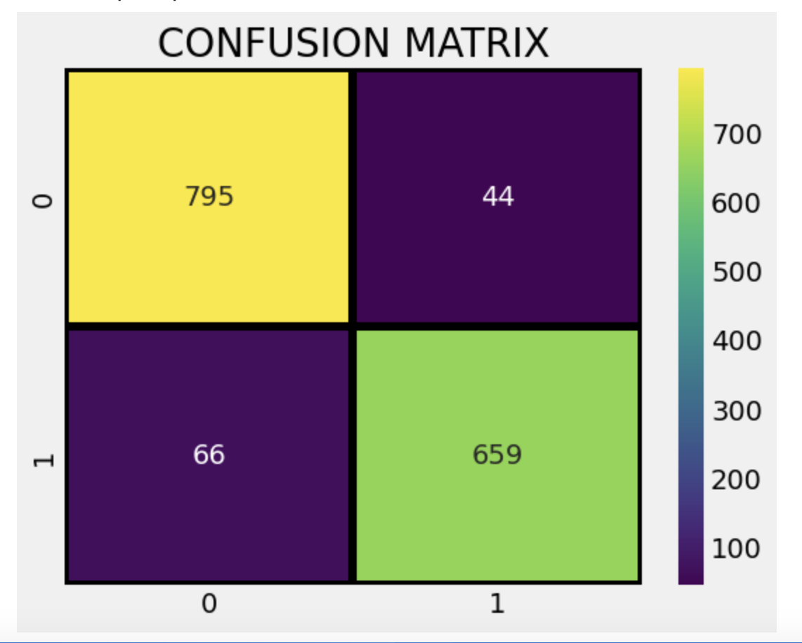
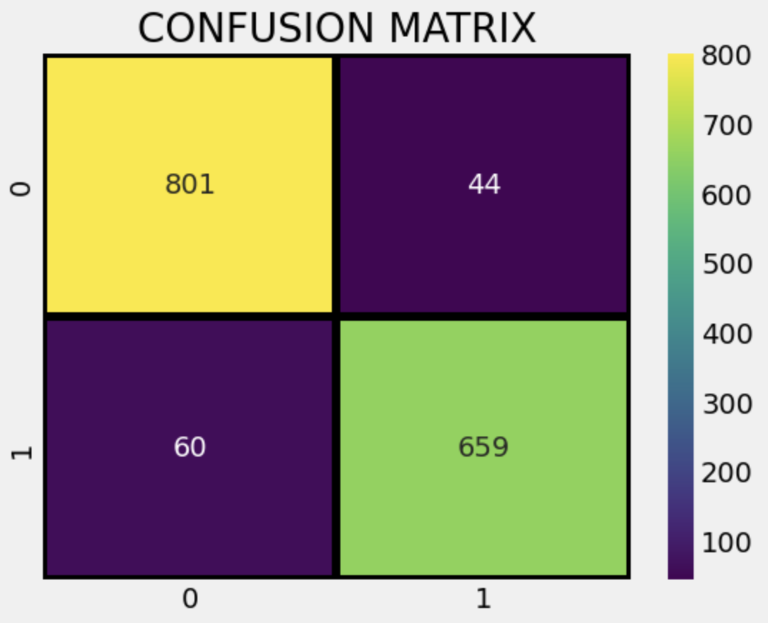
Tutorial 3: Innovation
Used the same data as tutorial 2.
K-NN
0.9296675191815856
Decision Tree
0.9335038363171355

Slide 8
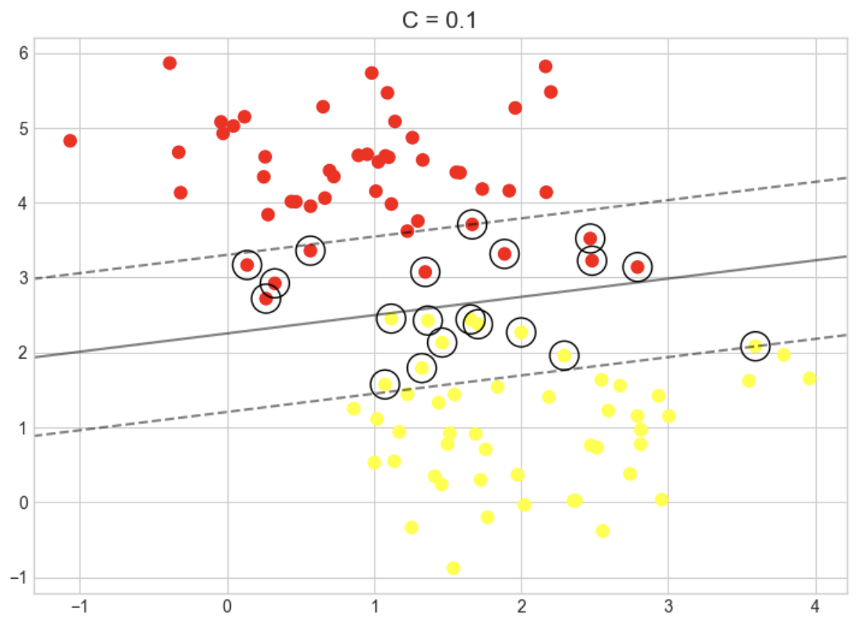
Tutorial 3-1: Support Vector Machine
Objective: Explore the intuition behind SVMs and their use in classification problems.

Slide 9
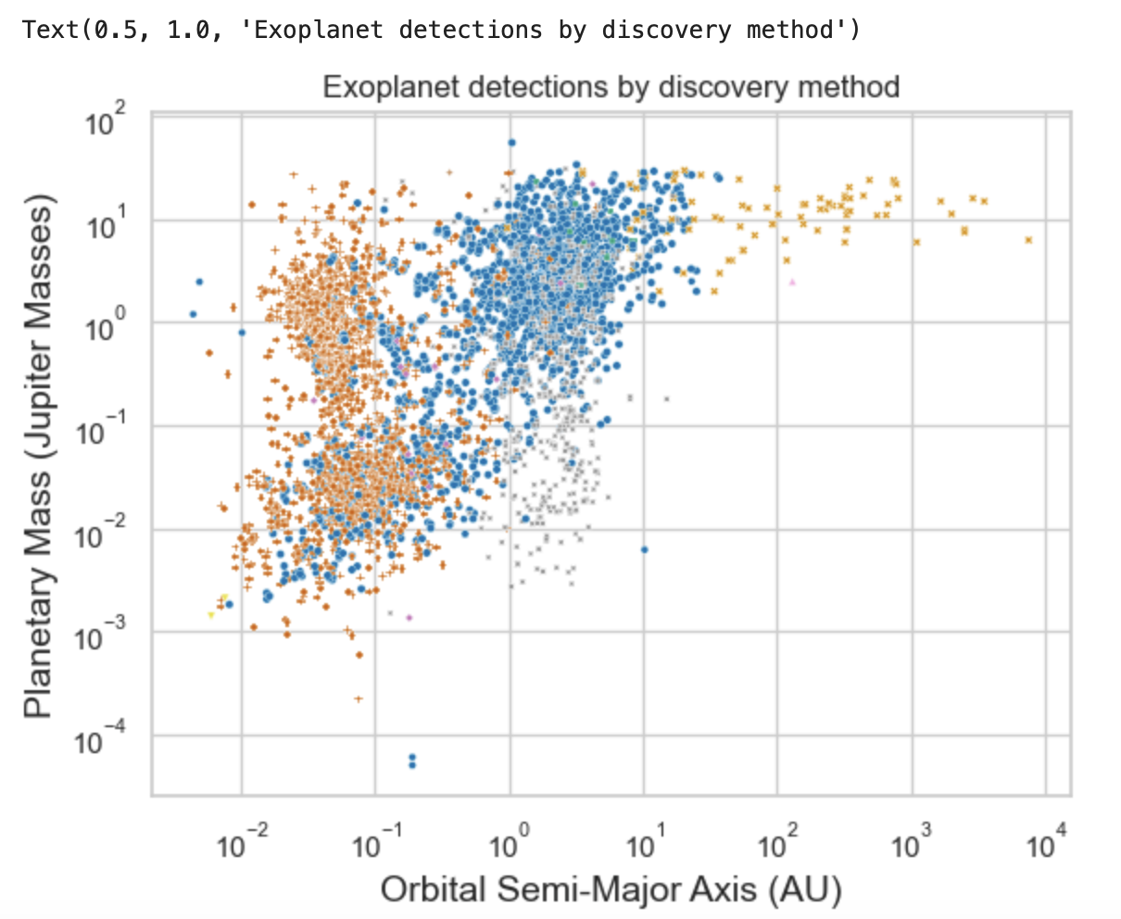
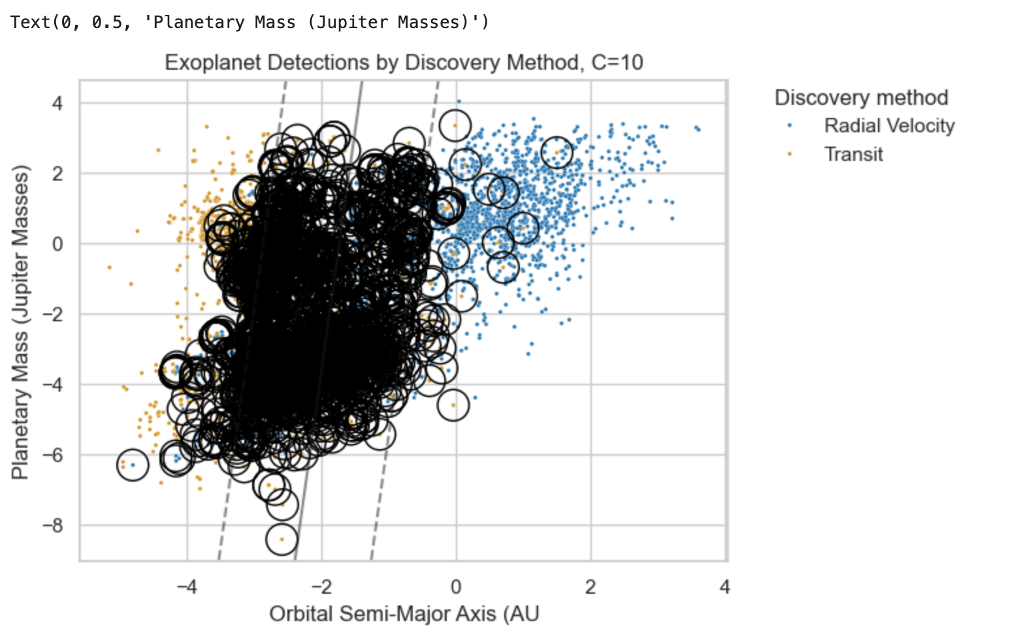
Tutorial 3-1: Innovation
We will apply Support Vector Machines (SVM) to the data from tutorial 2, to try to sort these detected exoplanets by discovery method.

Slide 10
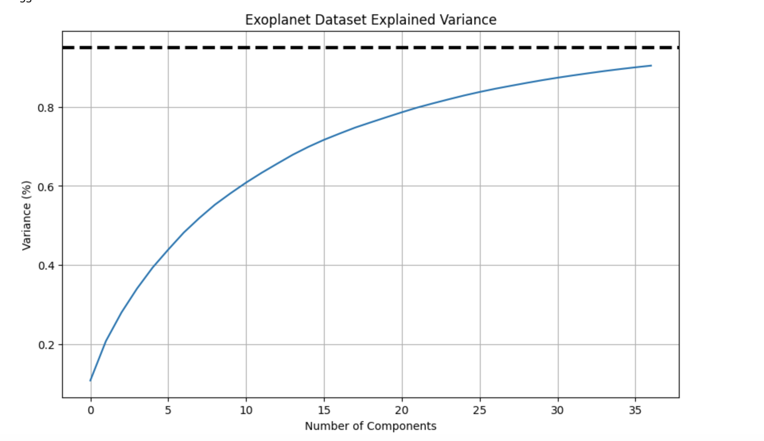
Tutorial 4: Artificial neural network technique applied on classification of exoplanets
Objective: Understand simple artificial neural network techniques applied on classification of exoplanets.

Slide 11
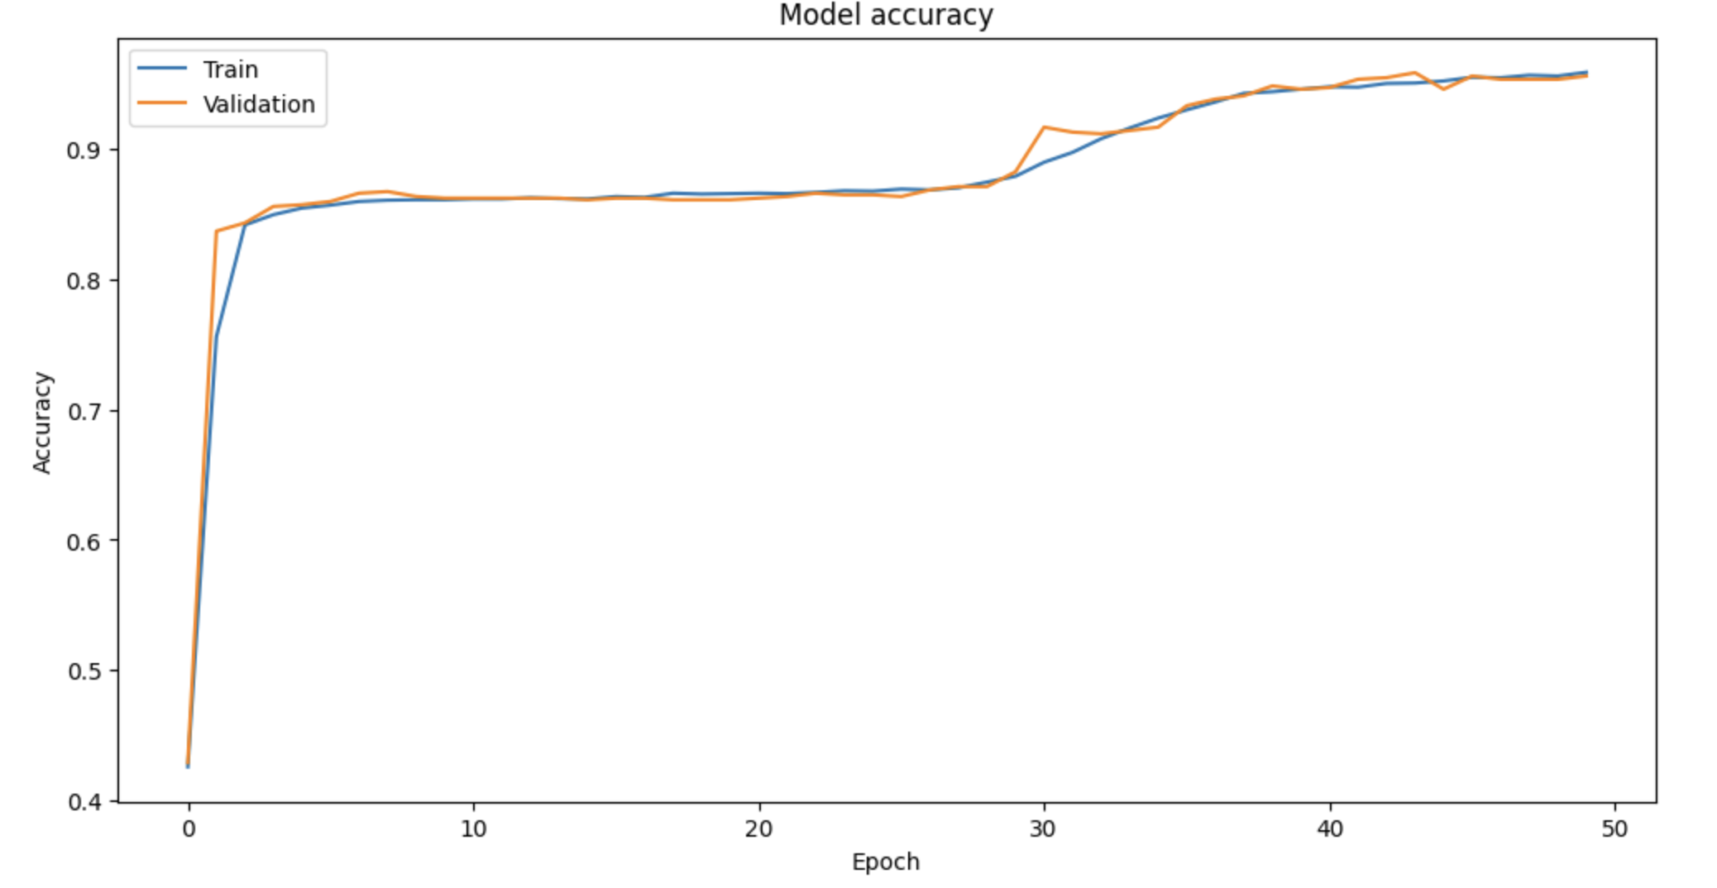
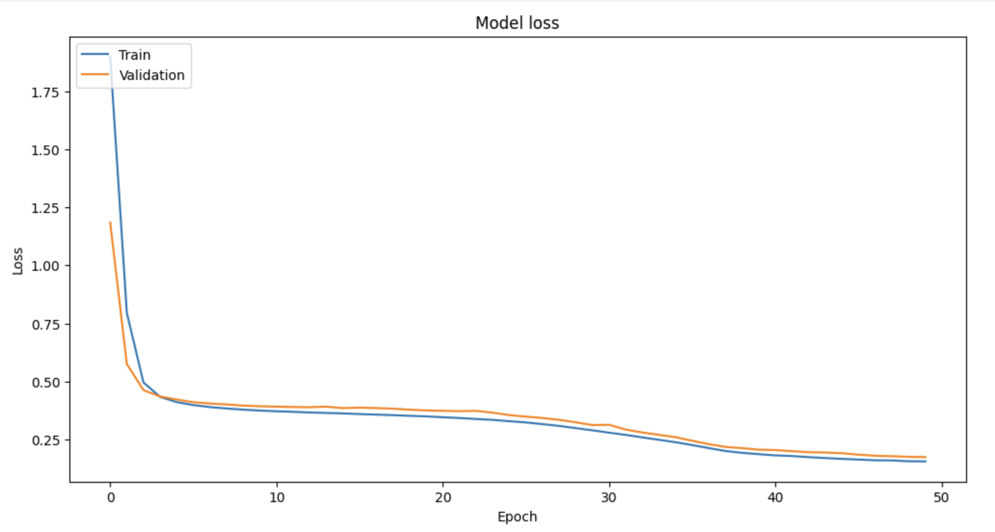

Tutorial 4: Innovation

Slide 12
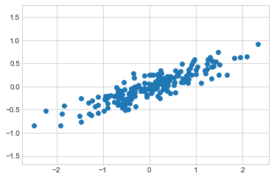
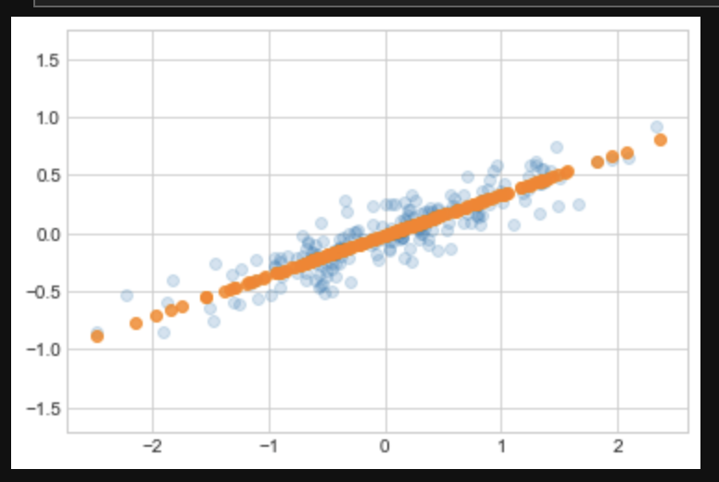
Tutorial PCA: Feature selection and dimensionality reduction
Objective: Introduce principal component analysis for feature selection and data dimensionality reduction.

Slide 13
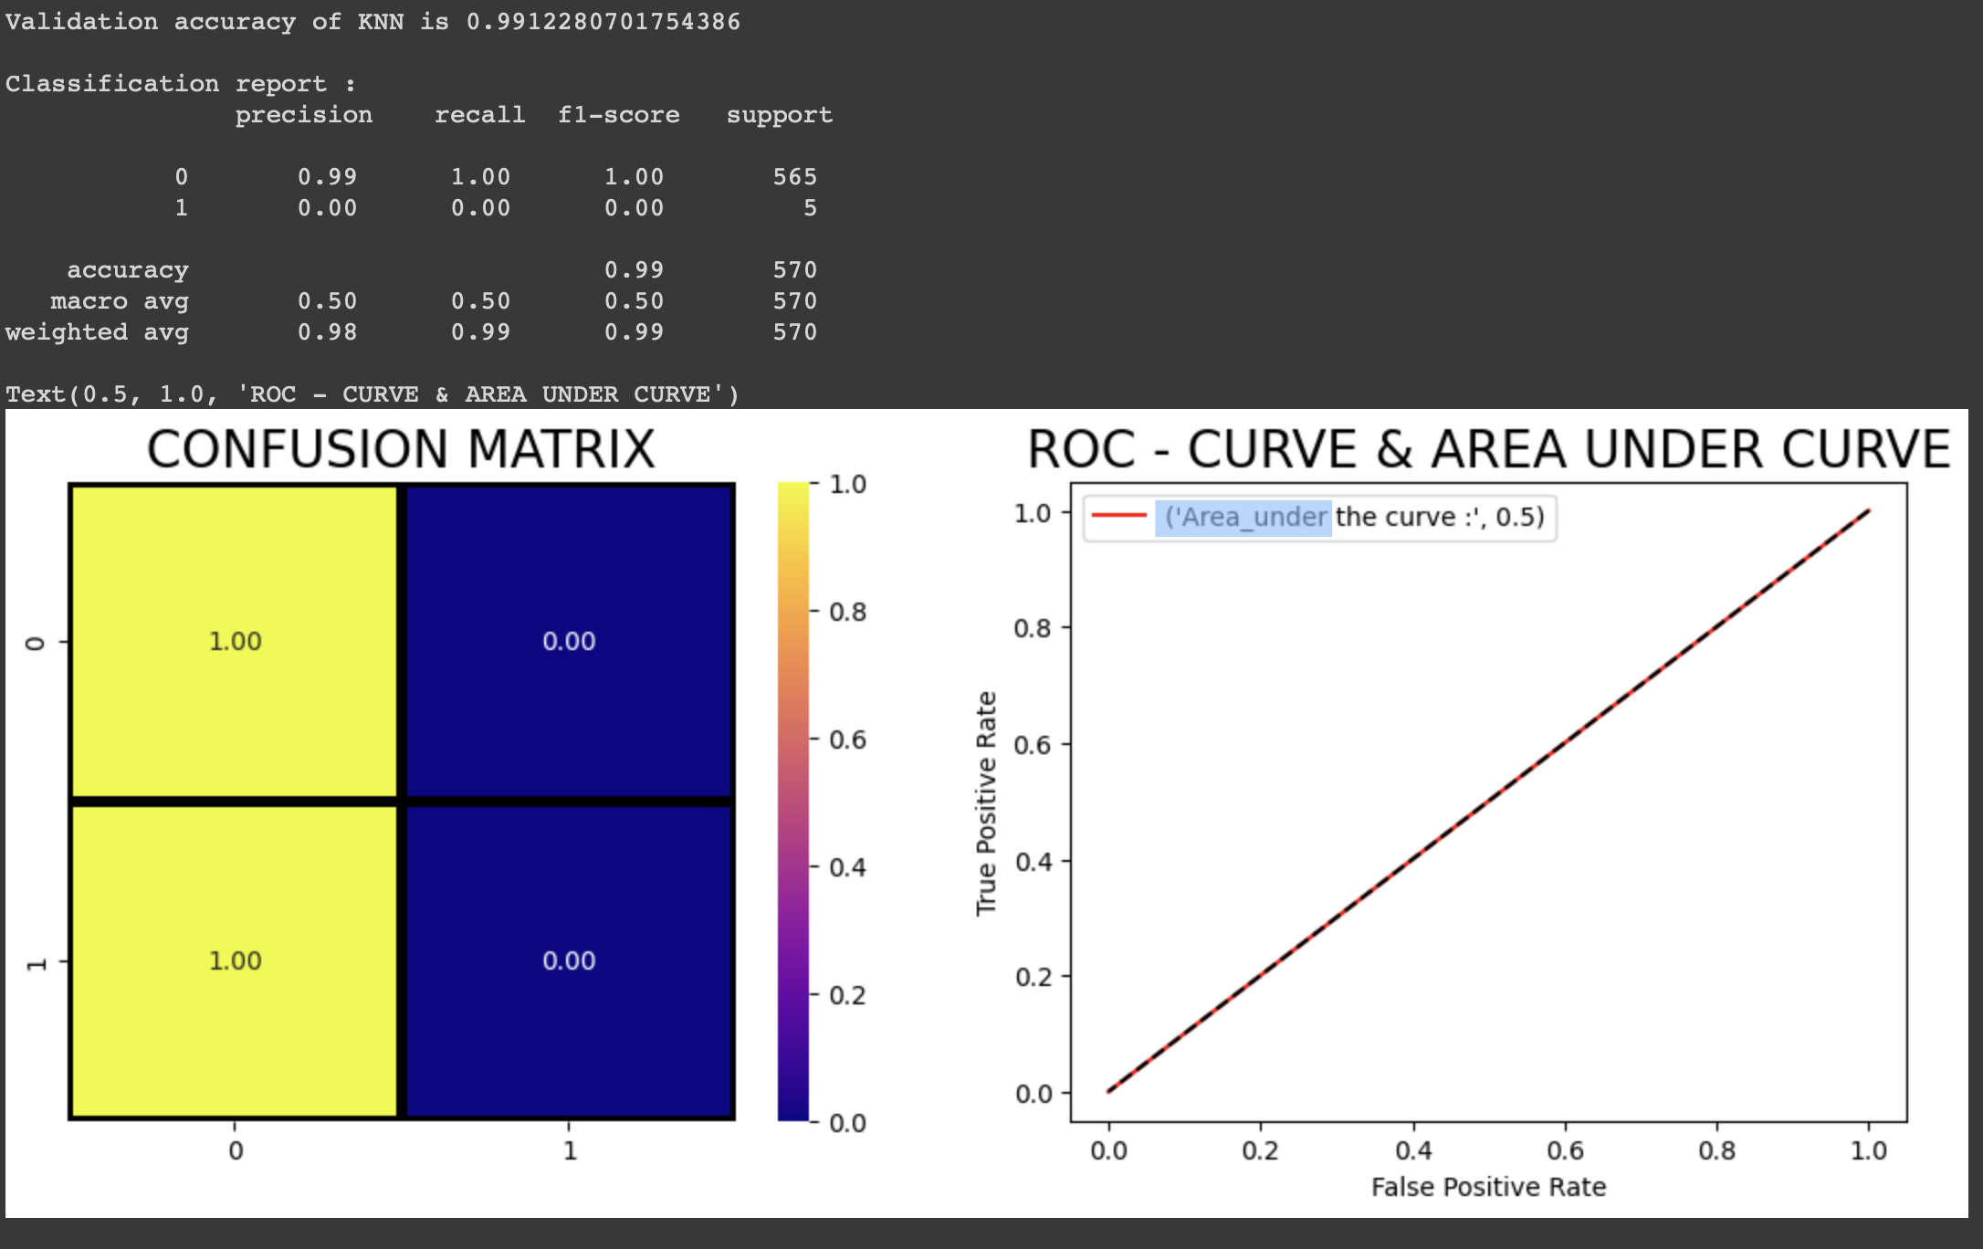
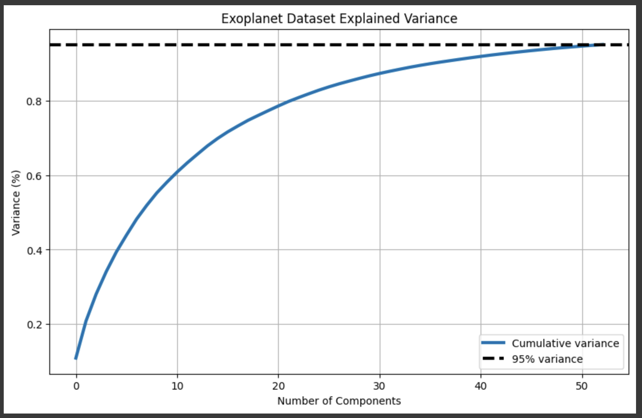
Tutorial PCA: Innovation

Slide 14
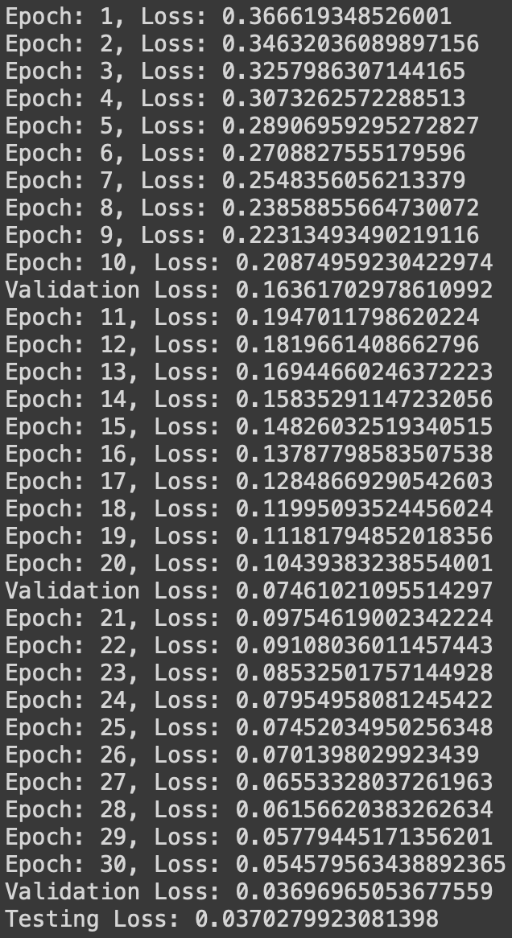
Tutorial 5: Application of Transformer Model on Classification of Habitable Exoplanets from LIFE Sim
Objective: Understand the Transformer Architecture.

Slide 15

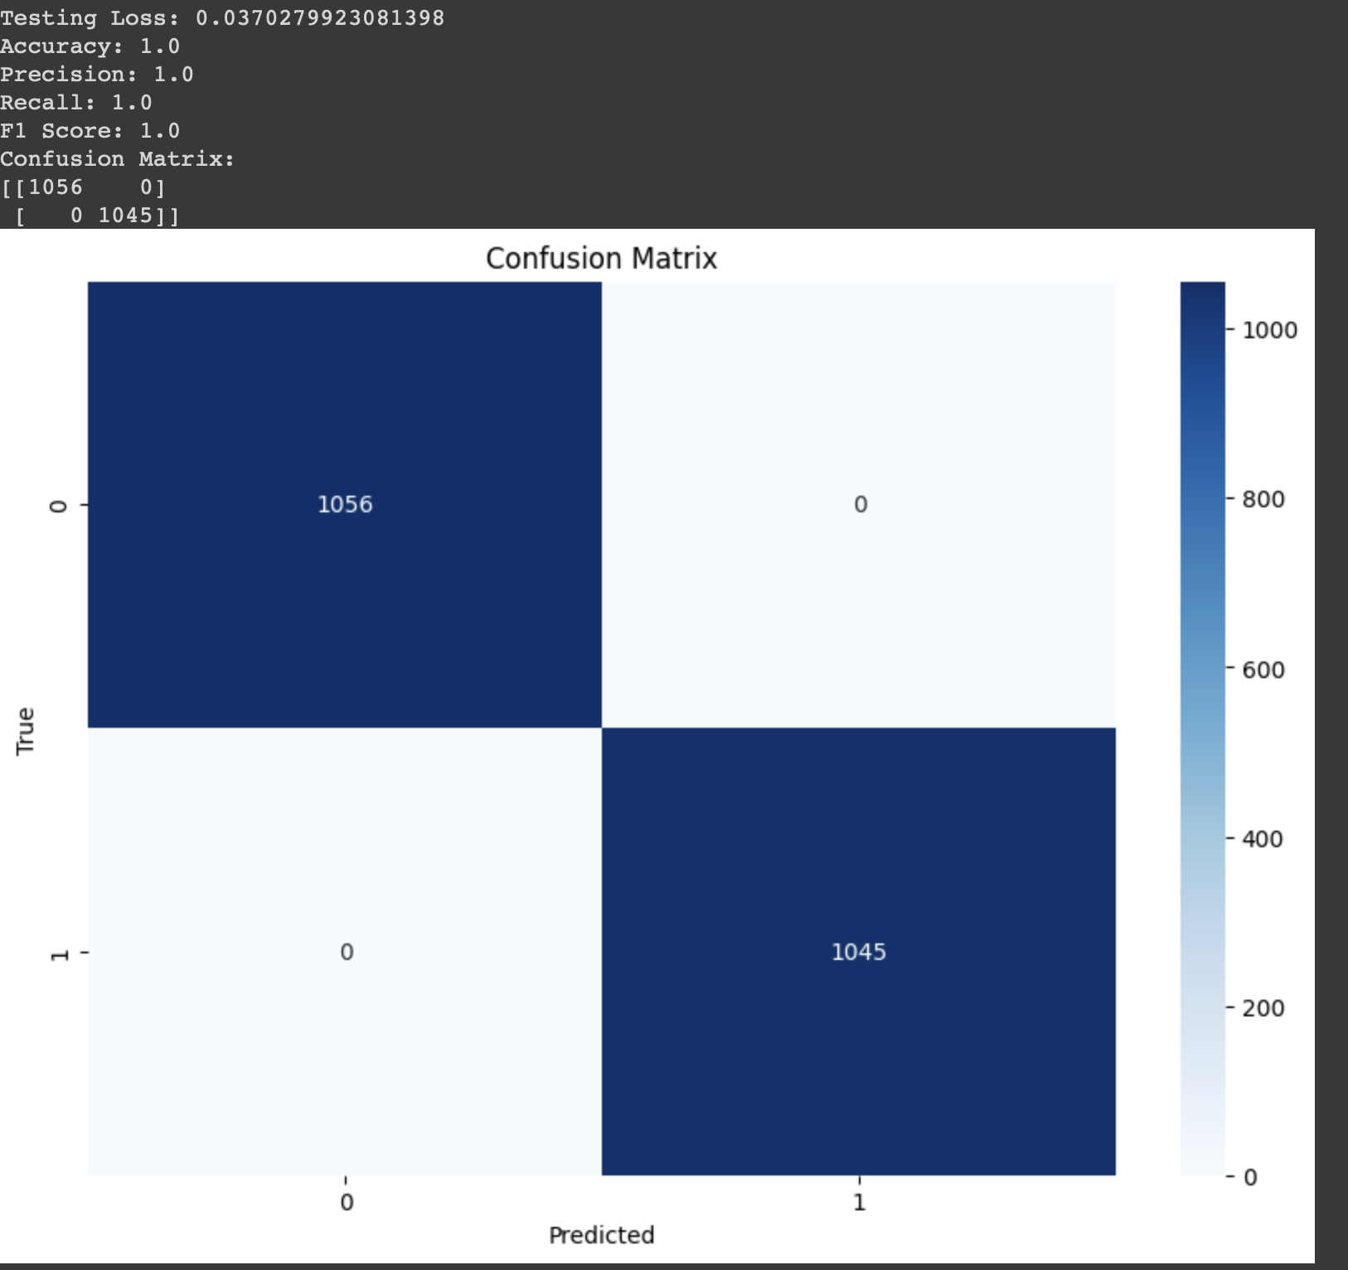
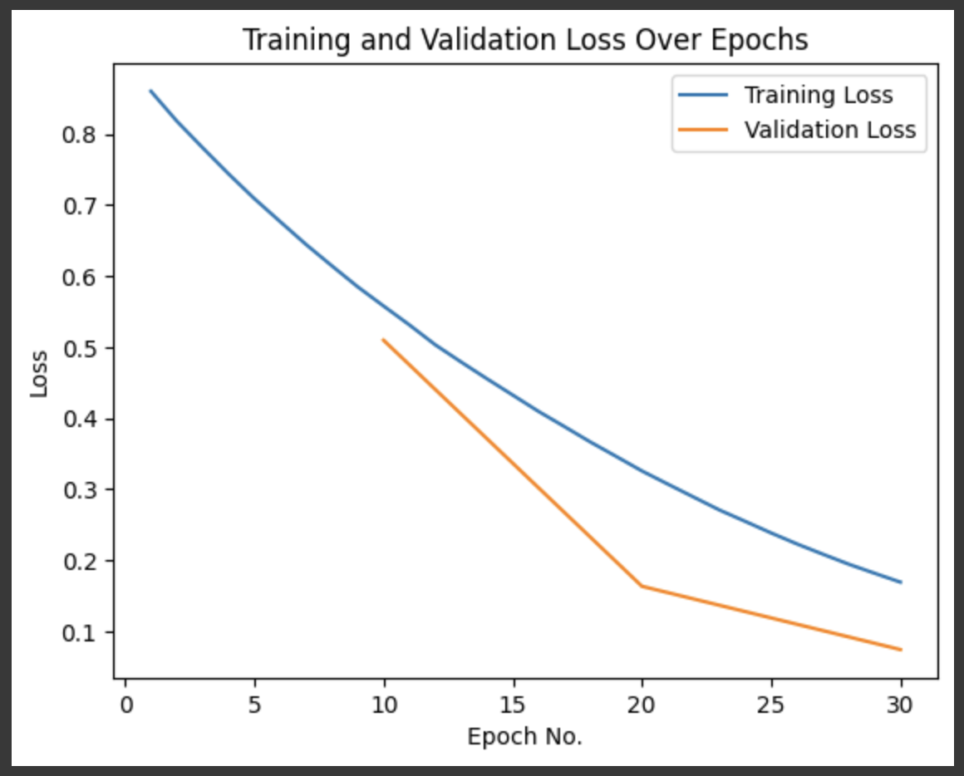
Tutorial 5: Innovation

